Slide 1

Project Name: Seasonal Agriculture Performance Analysis
Payal Pravin Thombare College Name: Sharad Institute of Technology College of Engineering
AICTE STU ID: STU6763a876e4f491734584438

Slide 2

PROBLEM STATEMENT
Agricultural performance changes with seasonal environmental conditions, farming practices, resource availability and market conditions. Raw farm-level data does not clearly reveal these differences. The project analyzes 4,000 farm-season records to identify meaningful seasonal patterns, trends, relationships and variations in yield, profitability, resource use and environmental conditions.

Slide 3
PROJECT DESCRIPTION
• Analyses 4,000 farm-season records across 8 states, 8 crops, 3 seasons and 4 irrigation methods.
• Covers yield, production, revenue, cost, profit, rainfall, soil, nutrients, water use and disease/pest risk.
• Workflow: Data understanding → Data cleaning → EDA → Seasonal/resource/economic analysis → Statistical testing → KPI dashboard → Recommendations.
• All KPIs and findings are calculated directly from the dataset; no hard-coded analytical results.
A complete data-driven analytics workflow that converts raw agricultural records into statistically validated insights and an actionable dashboard.

Slide 4

WHO ARE THE END USERS?
• Farmers and farm managers — compare seasonal performance and irrigation choices.
• Agricultural officers and planners — support evidence-based seasonal planning and resource programs.
• Agribusiness analysts — evaluate profitability, production and market-linked performance.
• Researchers and students — study relationships between environment, resources and agricultural outcomes.

Slide 5

TECHNOLOGY USED
• Python 3 — core programming and analytics language
• Jupyter Notebook — development, analysis and reproducible workflow
• Pandas & NumPy — data loading, cleaning, transformation and numerical analysis
• Matplotlib & Seaborn — charts, statistical visuals and final dashboard
• SciPy — ANOVA, Welch’s t-test and Spearman correlation

Slide 6
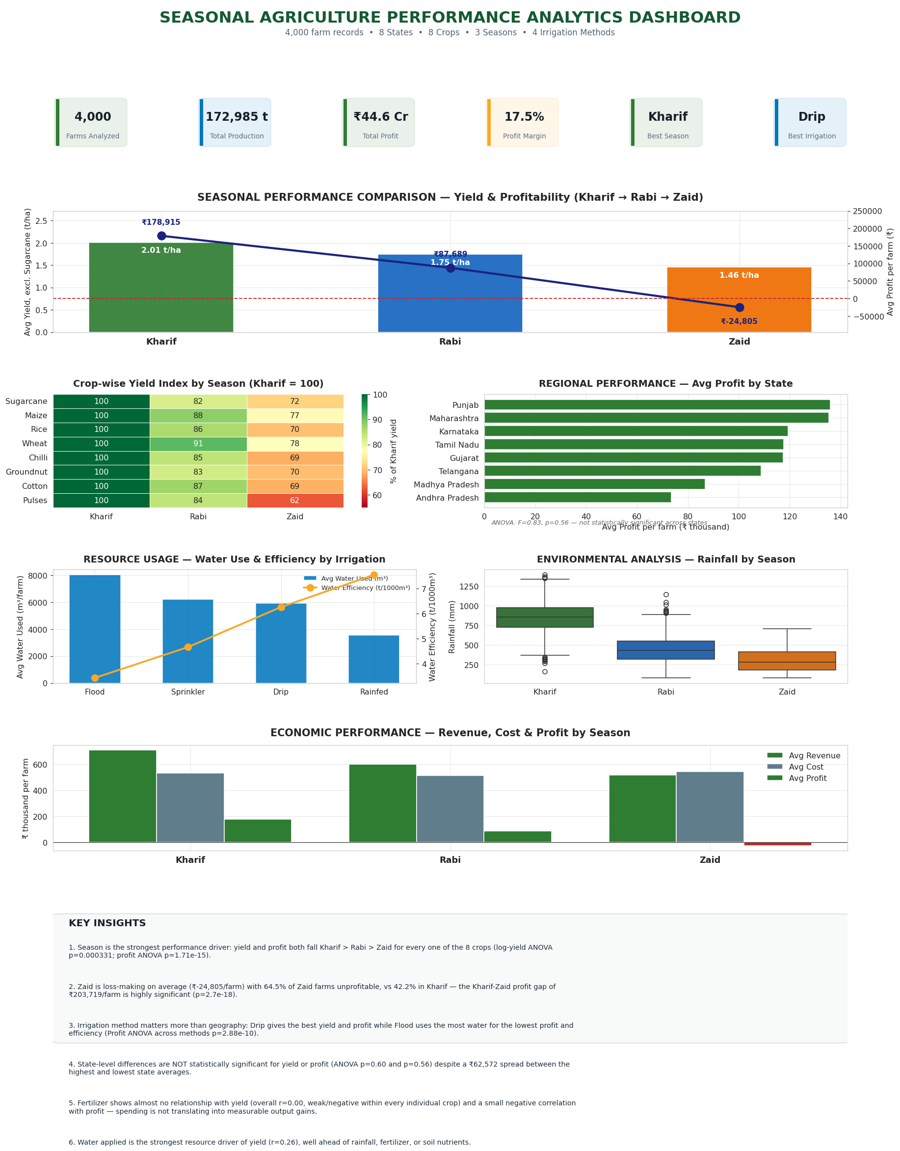
RESULTS

Slide 7
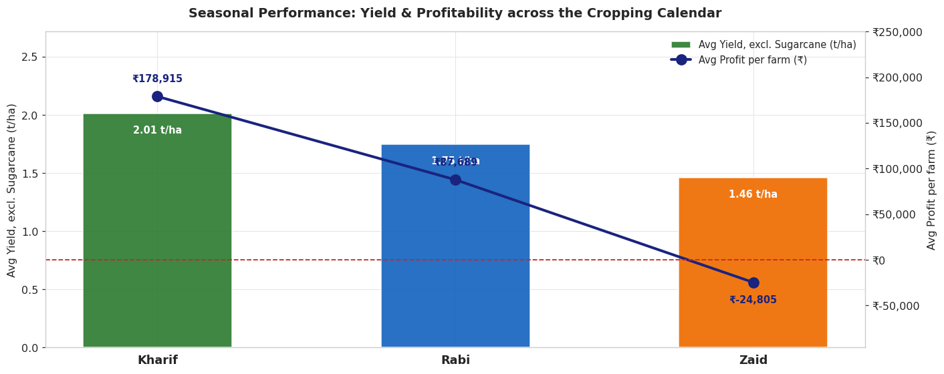
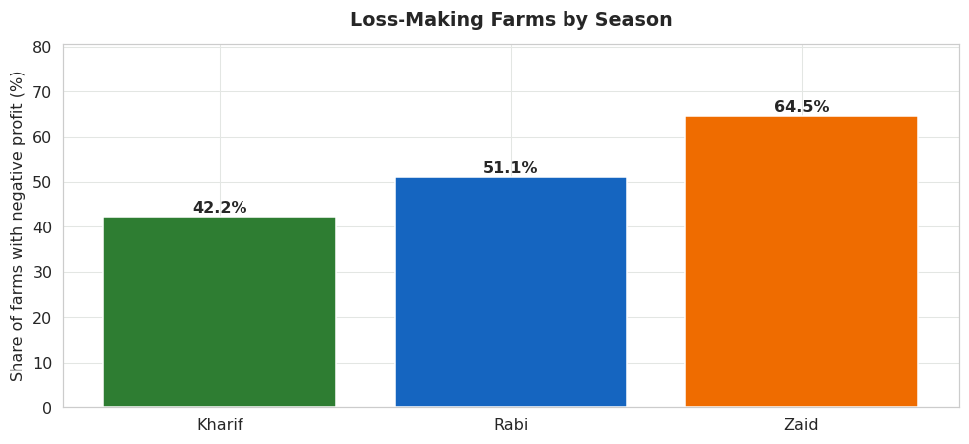
RESULTS
• Average yield excluding Sugarcane: Kharif 2.01 t/ha, Rabi 1.75 t/ha, Zaid 1.46 t/ha.
• Average profit: ₹178,915 (Kharif), ₹87,689 (Rabi), and −₹24,805 (Zaid).
• Loss-making farms rise from 42.2% in Kharif to 64.5% in Zaid.

Slide 8
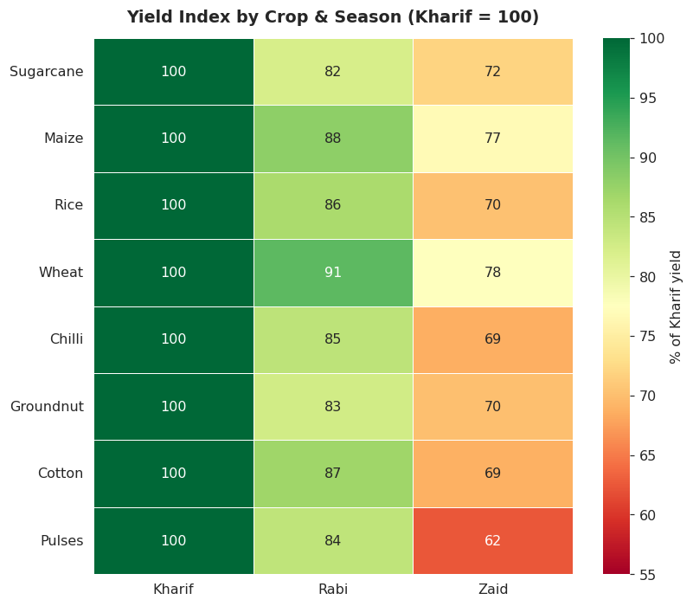
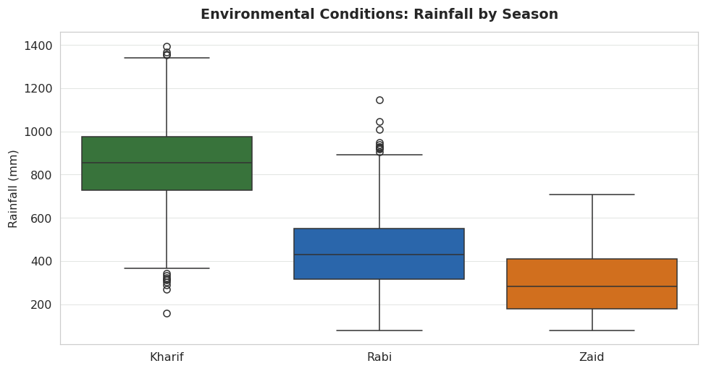
RESULTS
• Kharif > Rabi > Zaid yield pattern holds for all 8 crops.
• Mean rainfall falls from about 852 mm in Kharif to 436 mm in Rabi and 299 mm in Zaid.

Slide 9
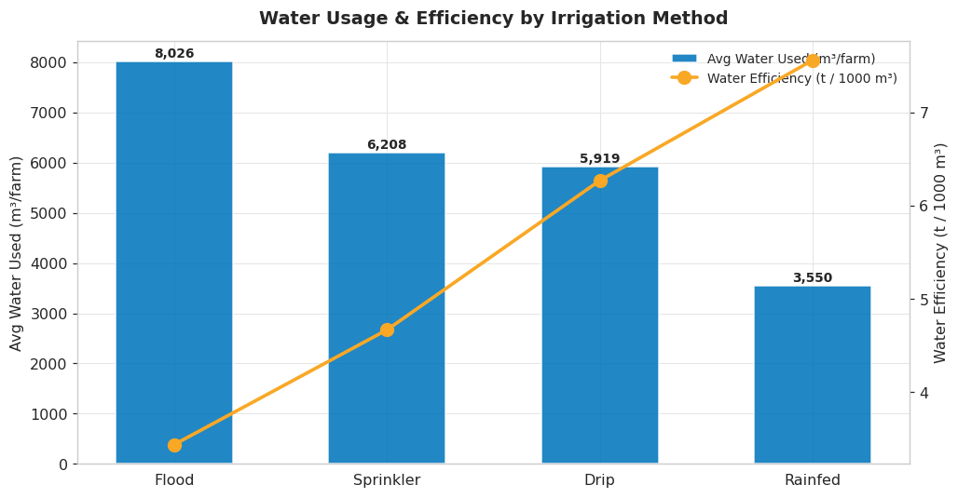
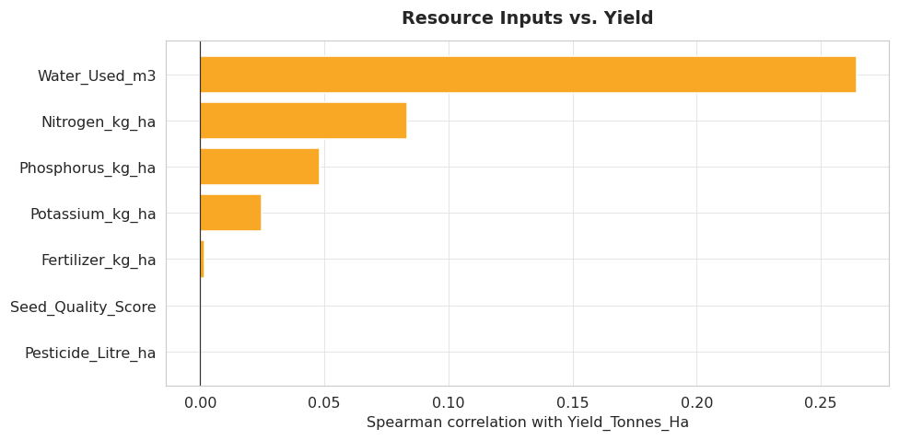
RESULTS
• Drip irrigation provides the best yield and profit performance; Flood uses the most water with the lowest efficiency/profit.
• Water used has the strongest positive resource relationship with yield (Spearman r = 0.264); fertilizer is essentially unrelated (r = 0.002).

Slide 10
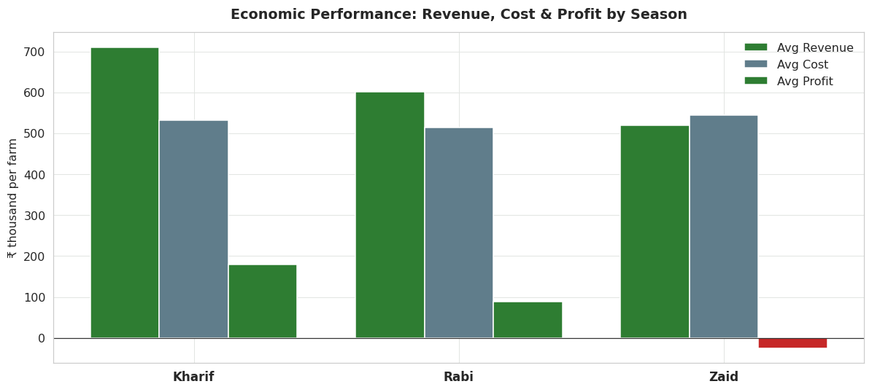
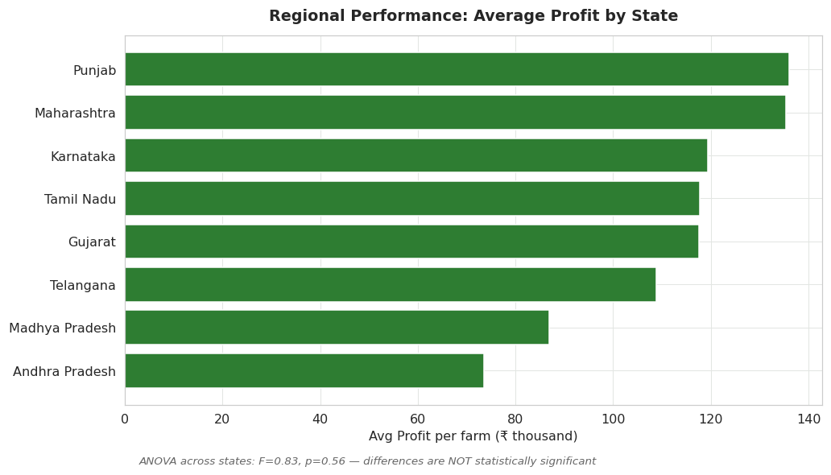
RESULTS
• Overall: ₹255.1 Cr revenue, ₹210.5 Cr cost, ₹44.6 Cr profit and 17.5% profit margin.
• Season effect is significant: log(Yield) ANOVA p=0.00033; Profit ANOVA p<0.001.
• Irrigation effect is significant for yield and profit (p<0.001), while State is not significant (p≈0.60 / 0.56).

Slide 11
FUTURE SCOPE
• Extend the dataset to multiple years to study year-over-year seasonal trends.
• Integrate live weather, soil-moisture and market-price data for near-real-time monitoring.
• Develop predictive models for yield, profit and Zaid-season loss risk.
• Build crop- and region-specific recommendation modules for irrigation and resource planning.
• Deploy the analytics dashboard as an interactive web application for field-level decision support.

Slide 12
GITHUB LINK
GitHub Repository
https://github.com/PayalThombare/Seasonal-Agriculture-Performance-Analysis

Slide 13

VOIS Course Completion Certificate Course: Data Visualization

Slide 14
Thank You
Seasonal Agriculture Performance Analysis
VOIS AICTE Batch 2026–2027
.
.

